Slide 1
Movie Recommender
IST - 736
Gianni Conde
Sahil Nanavaty
Sana Khan

Slide 2
Intro
Picking the right movie is important to retaining customers
Using genres helps to provide recommendations that will align with customers' interest
Using the descriptions can help identify niche or noir films that otherwise may not be found as easily

Slide 3
Dataset
Used an IMDB dataset that contained information on movies
Used the description to predict genres
Provide a recommendation for movies based on genre

Slide 4
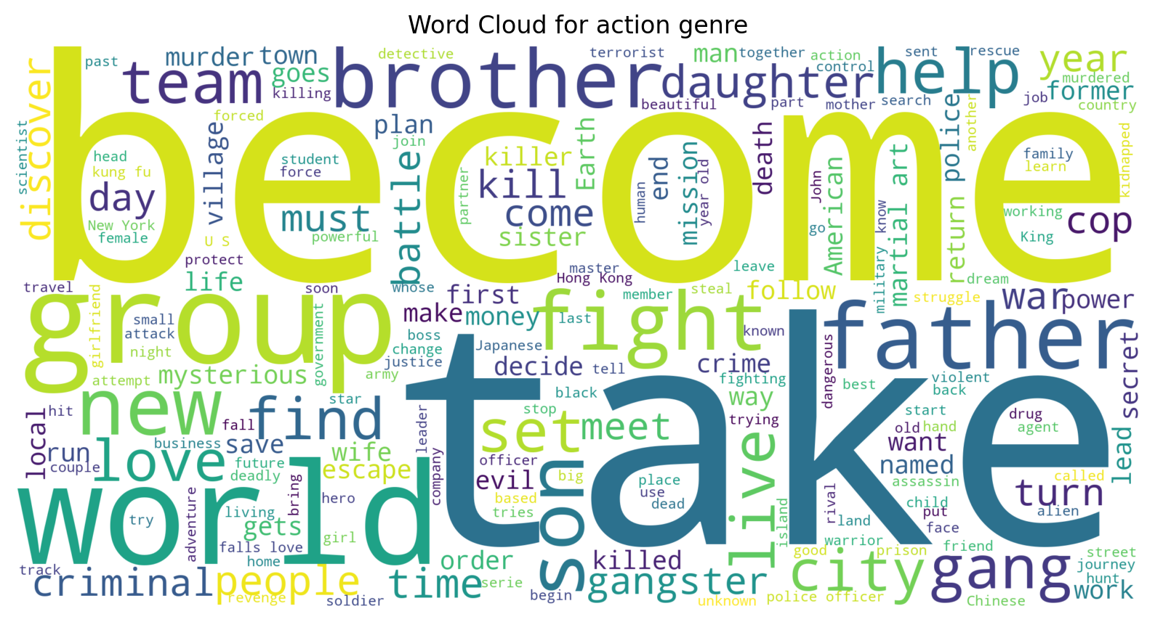
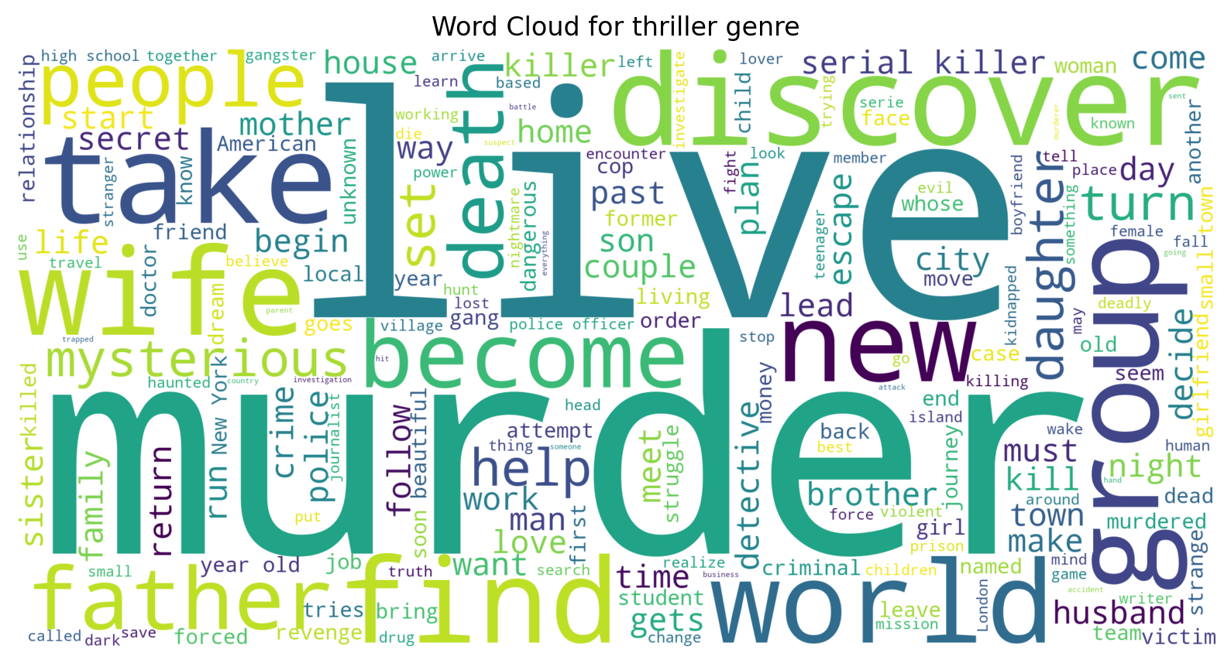
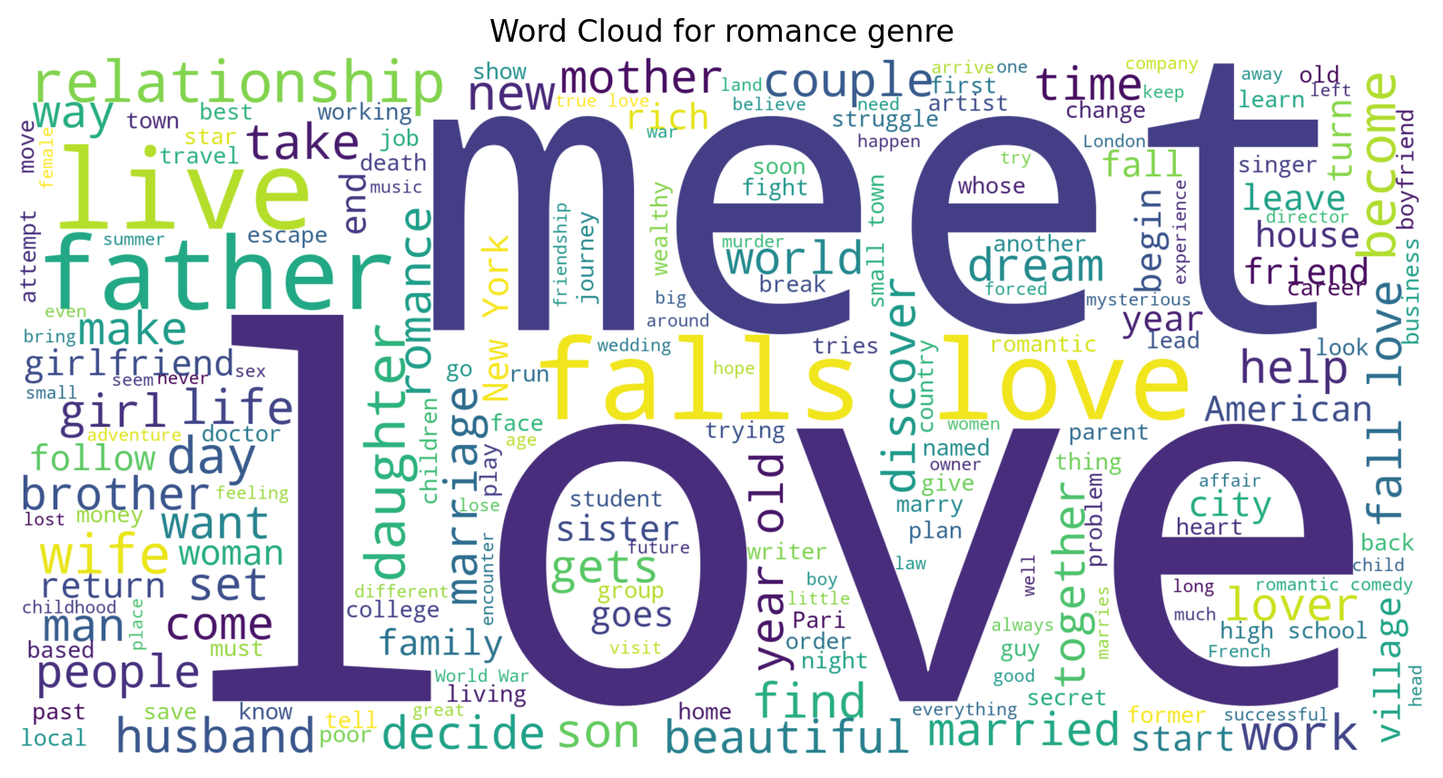
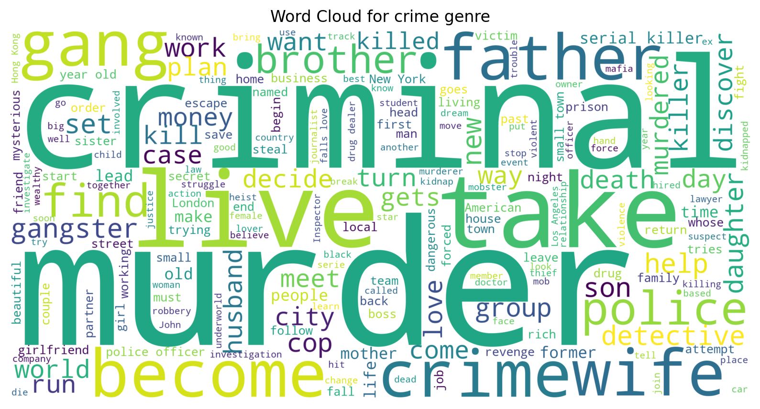
Word Clouds

Slide 5
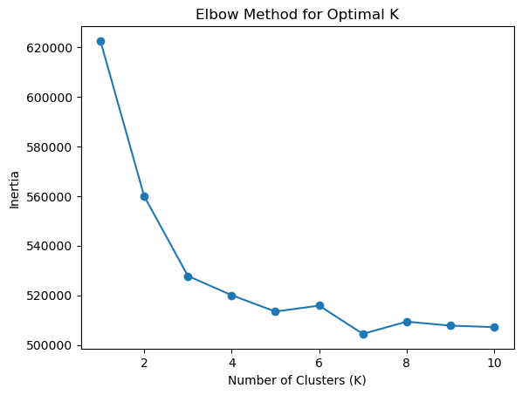
K means clustering
Elbow Method was used to determine number of clusters
3 is the optimal clusters for this dataset

Slide 6
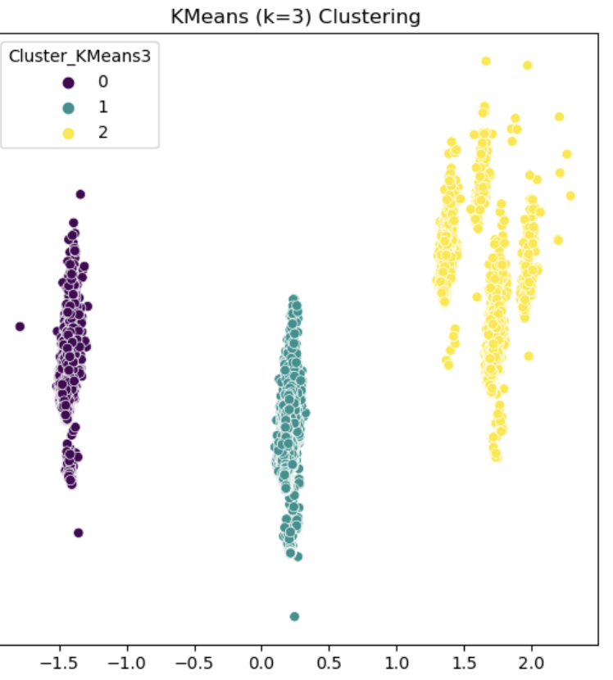
K means clustering
Cluster 0 & 1 have tight groups suggesting the variance in these clusters is smaller
The words in the description for this genre share common descriptors
Cluster 2 is more dispersed than the other clusters, suggesting more variability among description
Comedy vs romantic comedy

Slide 7
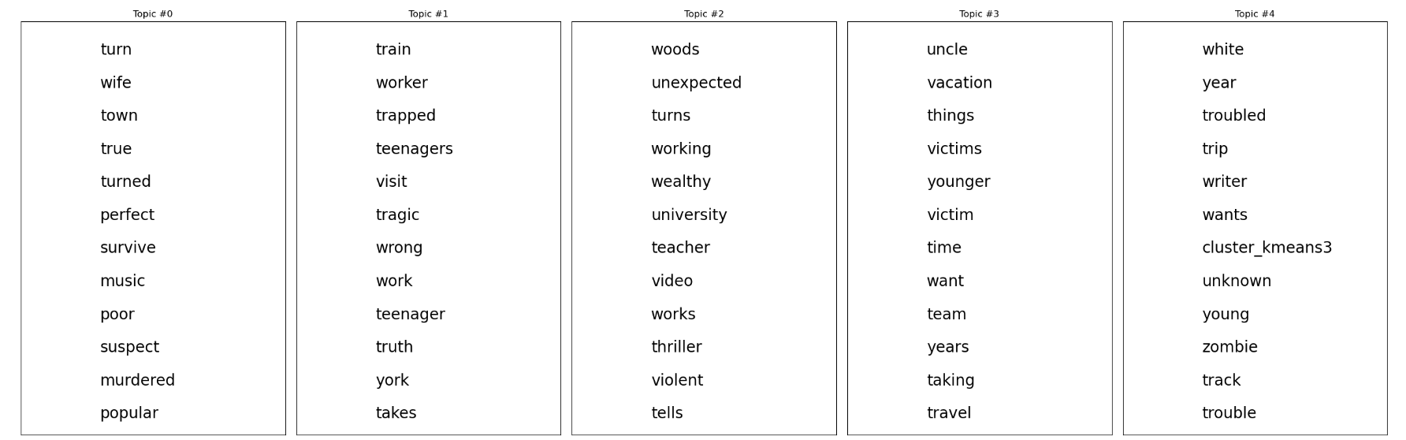
Topic Modeling
Overlap in words in the description caused overlap in topics
Movies can have more than one genre, which makes it difficult to provide definite words per topic

Slide 8
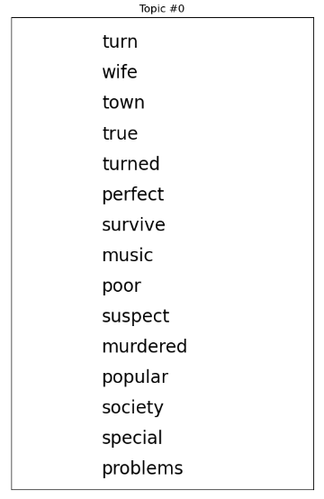
Topic 0
Crime Genre
Murdered
Survive
Poor
Suspect

Slide 9
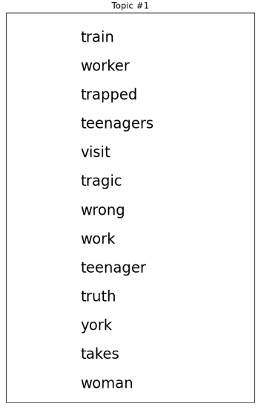
Topic 1
Romance Genre?
Woman
Tragic
Truth

Slide 10
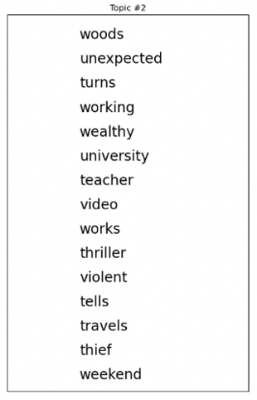
Topic 2
Horror Genre
Woods
Unexpected
Thriller
Violent
Travels

Slide 11
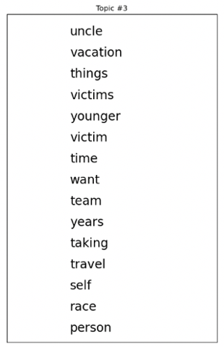
Topic 3
Sports Genre
Team
Travel
Race

Slide 12
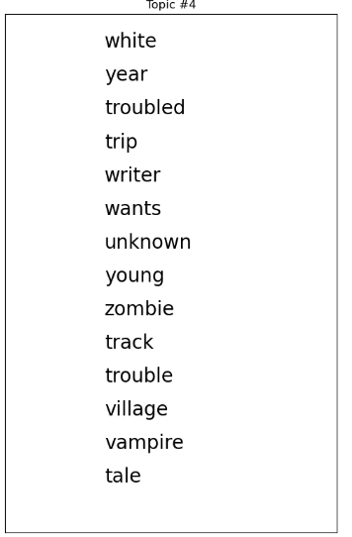
Topic 4
SciFi Genre
Zombie
Vampire
Tale

Slide 13
Conclusion

